Slide 1

KARNATAKA DISEASE REPORT
ADITYA RAJ

Slide 2
About Dataset
Four datasets are provided in Excel format, representing distinct time periods The initial dataset covers the combined months of Jan-Feb, while the subsequent ones focus on individual months (April, May, and June).
HEALTHCARE SOLUTION
RTWO
In every dataset there are columns some are same some varies dataset to dataset Location, Age, Sex, Disease, Death, Time in, Death time, etc.
HEALTHCARE SOLUTION
RTWO
HEALTHCARE SOLUTION
RTWO
HEALTHCARE SOLUTION
RTWO

Slide 3

Challenges
If we load the dataset we will find that the dataset distribution is completely non-uniform.
Problem 1.
First the dataset is not continuous and if we try to merge directly from Jan to June then it will result in data loss and many of our row will get deleted
HEALTHCARE SOLUTION
RTWO
Fig 1.
In April dataset
Fig 2.
In Jan-Feb dataset
HEALTHCARE SOLUTION
RTWO
HEALTHCARE SOLUTION
RTWO
HEALTHCARE SOLUTION
RTWO

Slide 4
Challenges
Problem 2
In location there are many spelling mistakes also about 10 rows are from outside Karnataka.
Problem 3
In disease column there are 80+ unique disease and we have total only 241 row.
HEALTHCARE SOLUTION
RTWO
Fig 3. Delhi and tamil nadu
HEALTHCARE SOLUTION
RTWO
HEALTHCARE SOLUTION
RTWO
HEALTHCARE SOLUTION
RTWO

Slide 5
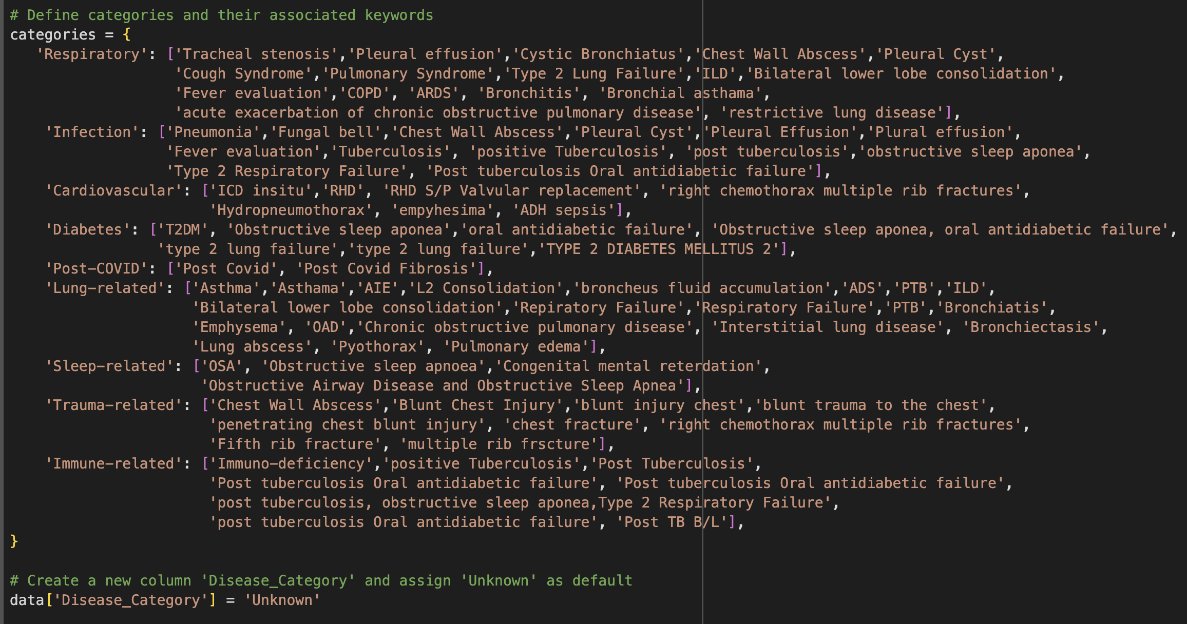
Challenges
HEALTHCARE SOLUTION
RTWO
Fig 4. Categories disease
HEALTHCARE SOLUTION
RTWO
HEALTHCARE SOLUTION
RTWO
HEALTHCARE SOLUTION
RTWO

Slide 6
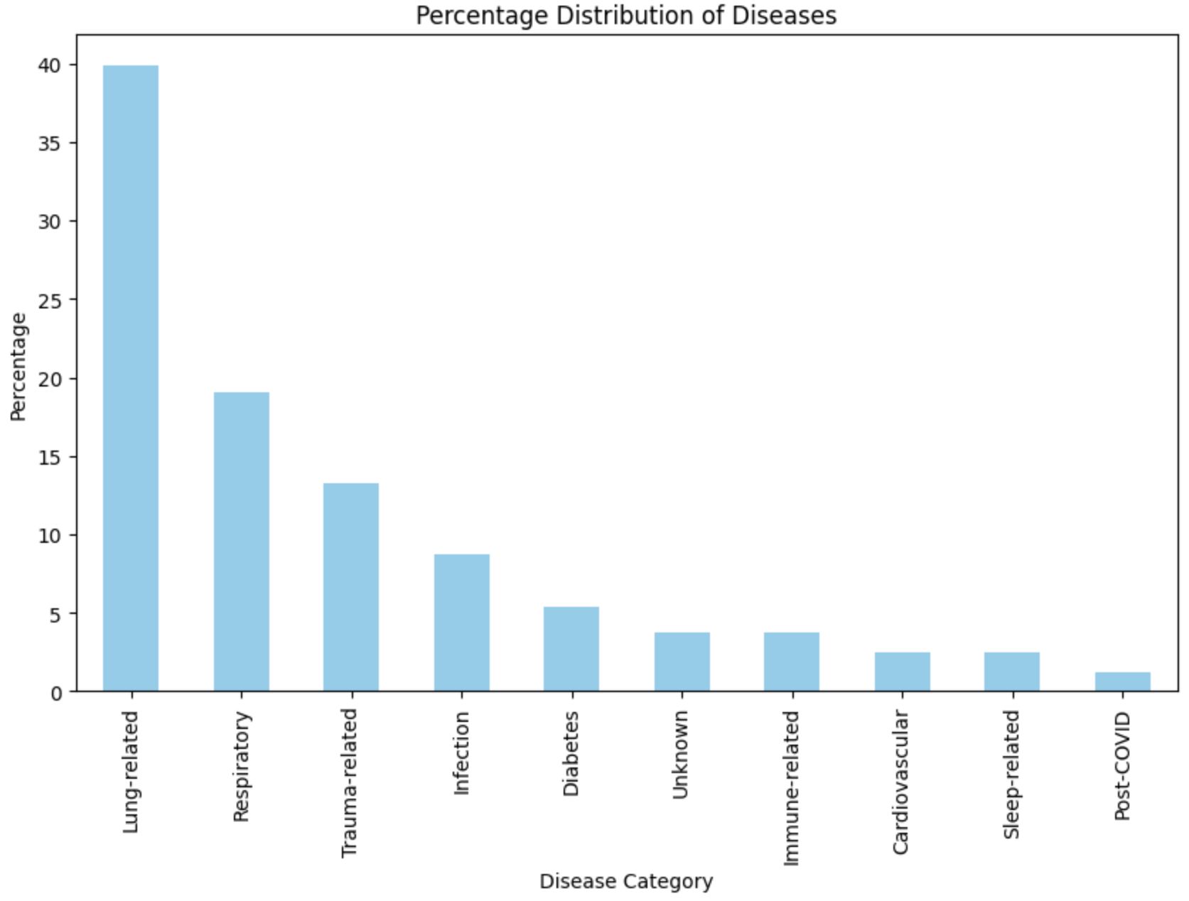
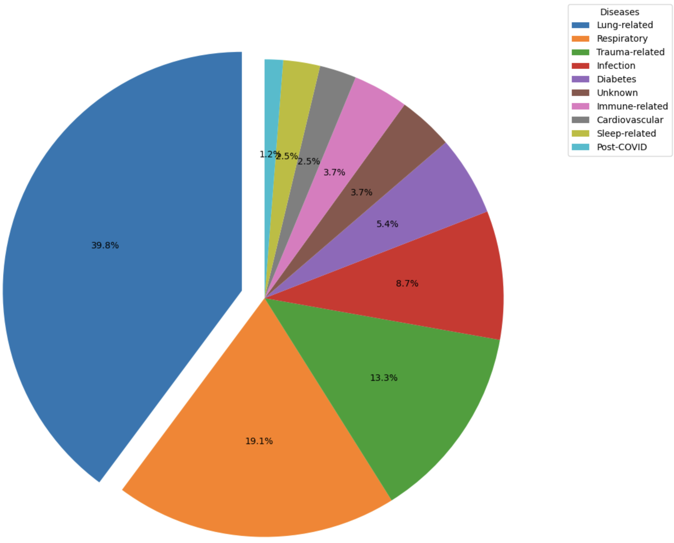
% of Diseases
Age vs Disease
Diseases based on Sex
HEALTHCARE SOLUTION
RTWO
Diseases based on Location
Diseases for Male on Location
Diseases for Female on Location
Age based on Location
HEALTHCARE SOLUTION
RTWO
HEALTHCARE SOLUTION
RTWO
HEALTHCARE SOLUTION
RTWO

Slide 7
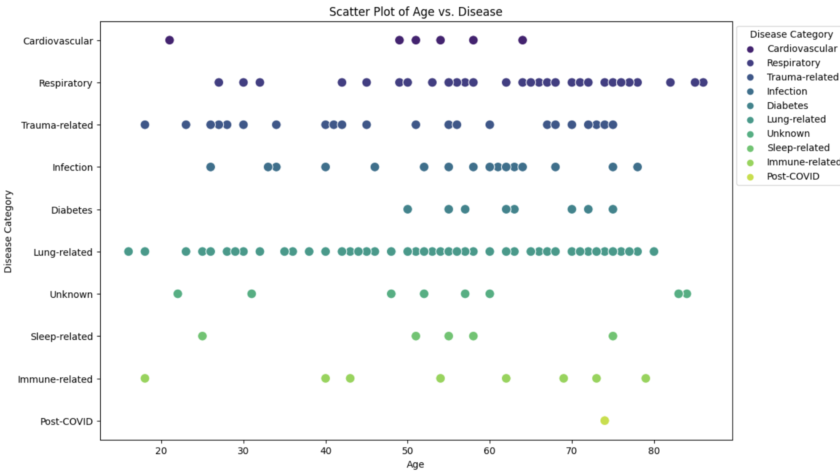
% of Diseases
Age vs Disease
Diseases based on Sex
HEALTHCARE SOLUTION
RTWO
Diseases based on Location
Diseases for Male on Location
Diseases for Female on Location
Age based on Location
HEALTHCARE SOLUTION
RTWO
HEALTHCARE SOLUTION
RTWO
HEALTHCARE SOLUTION
RTWO

Slide 8
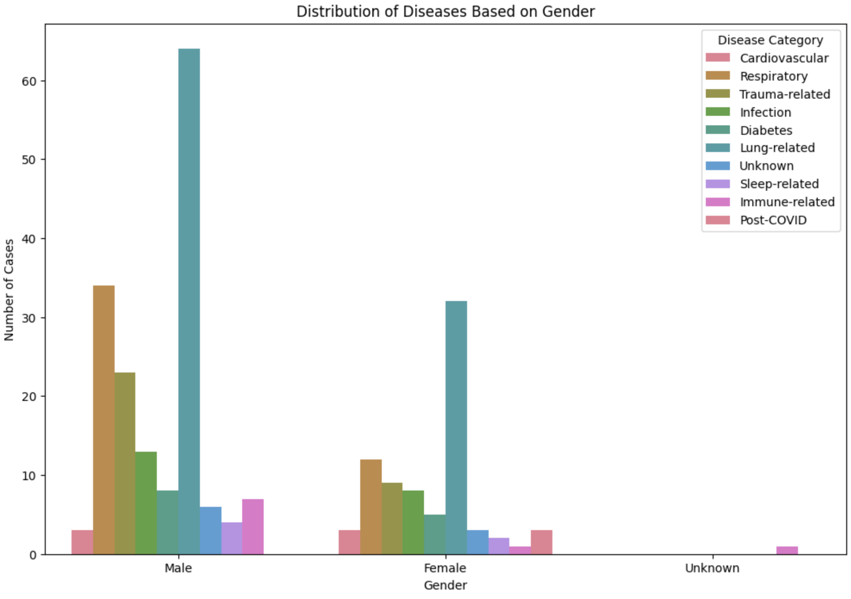
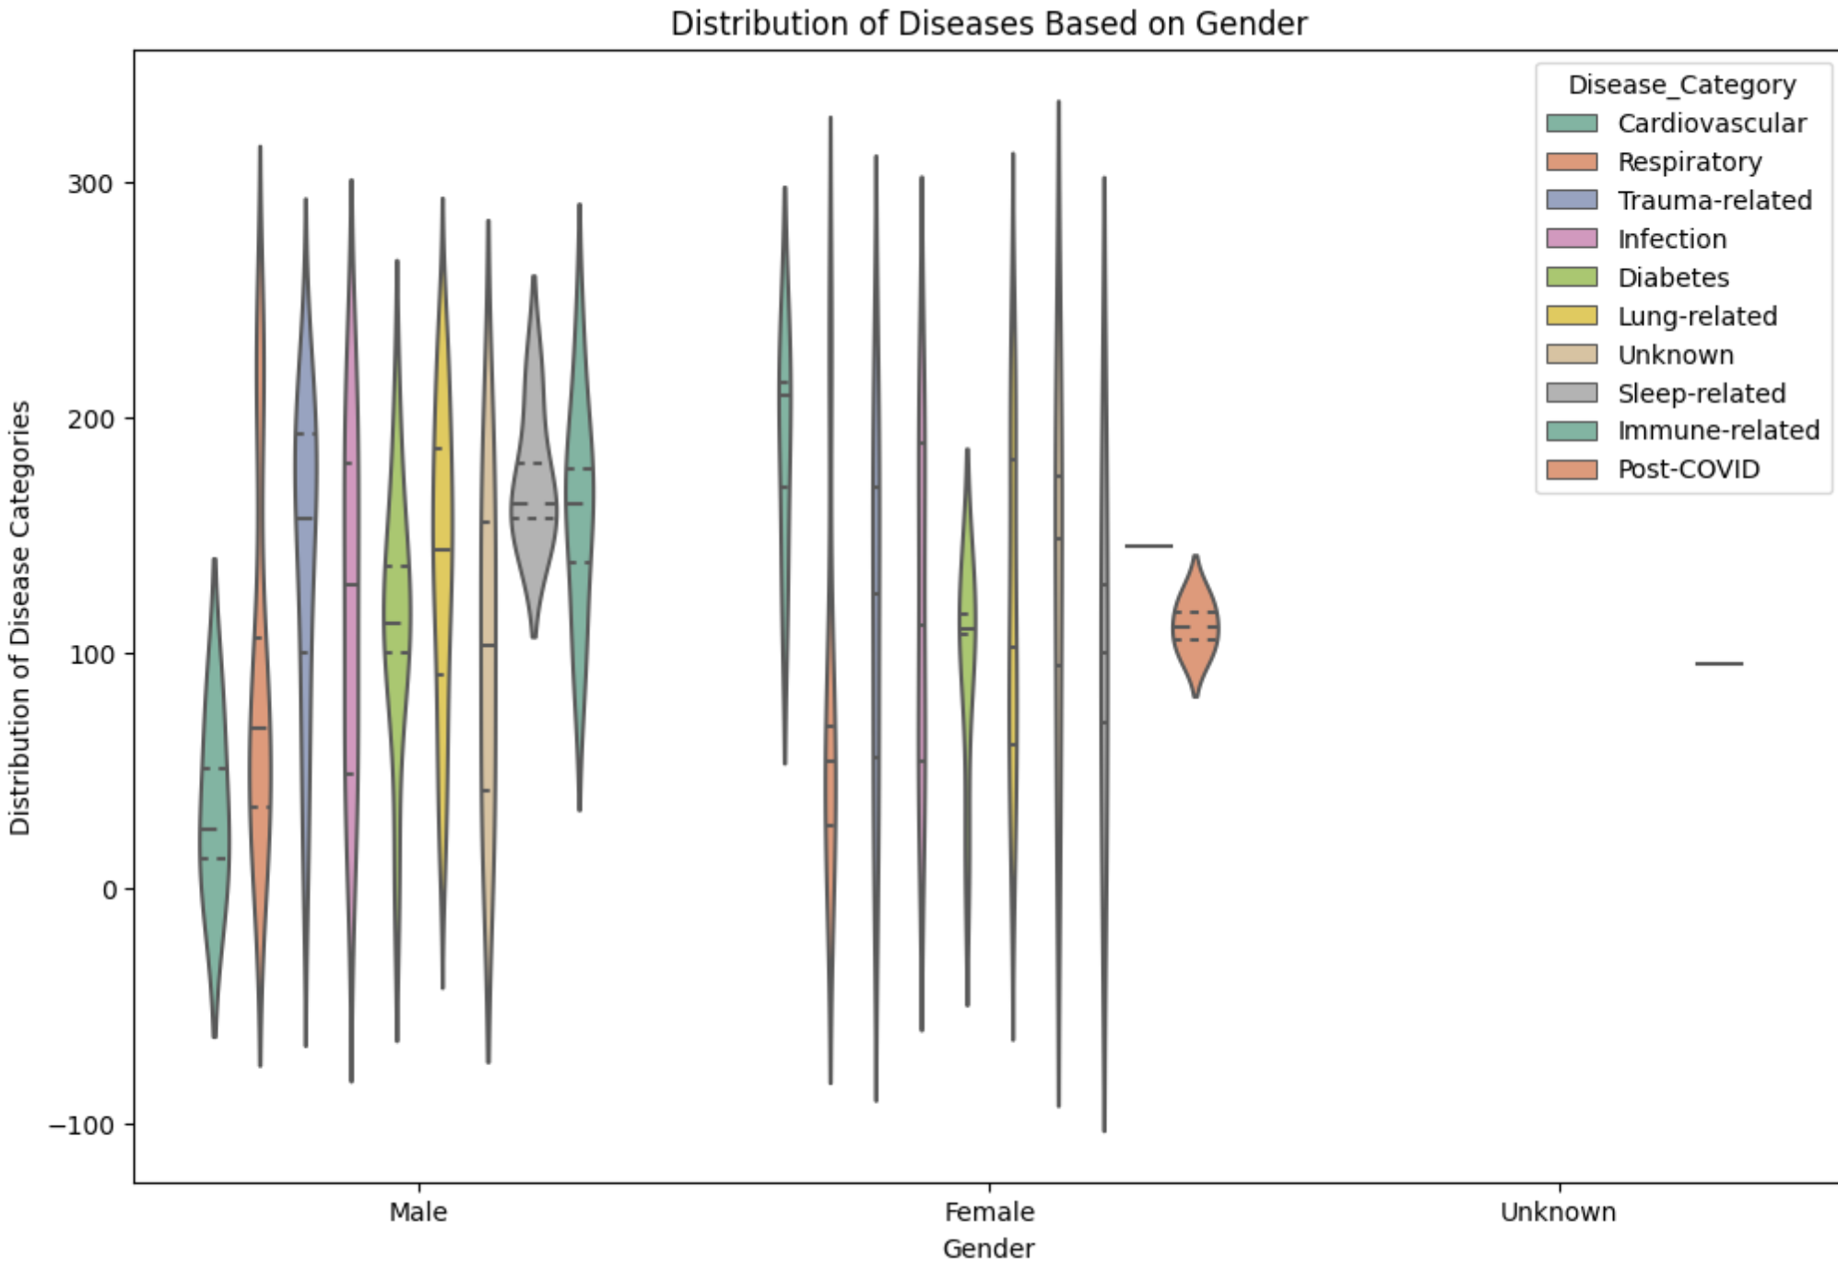
% of Diseases
Age vs Disease
Diseases based on Sex
HEALTHCARE SOLUTION
RTWO
Diseases based on Location
Diseases for Male on Location
Diseases for Female on Location
Age based on Location
HEALTHCARE SOLUTION
RTWO
HEALTHCARE SOLUTION
RTWO
HEALTHCARE SOLUTION
RTWO

Slide 9
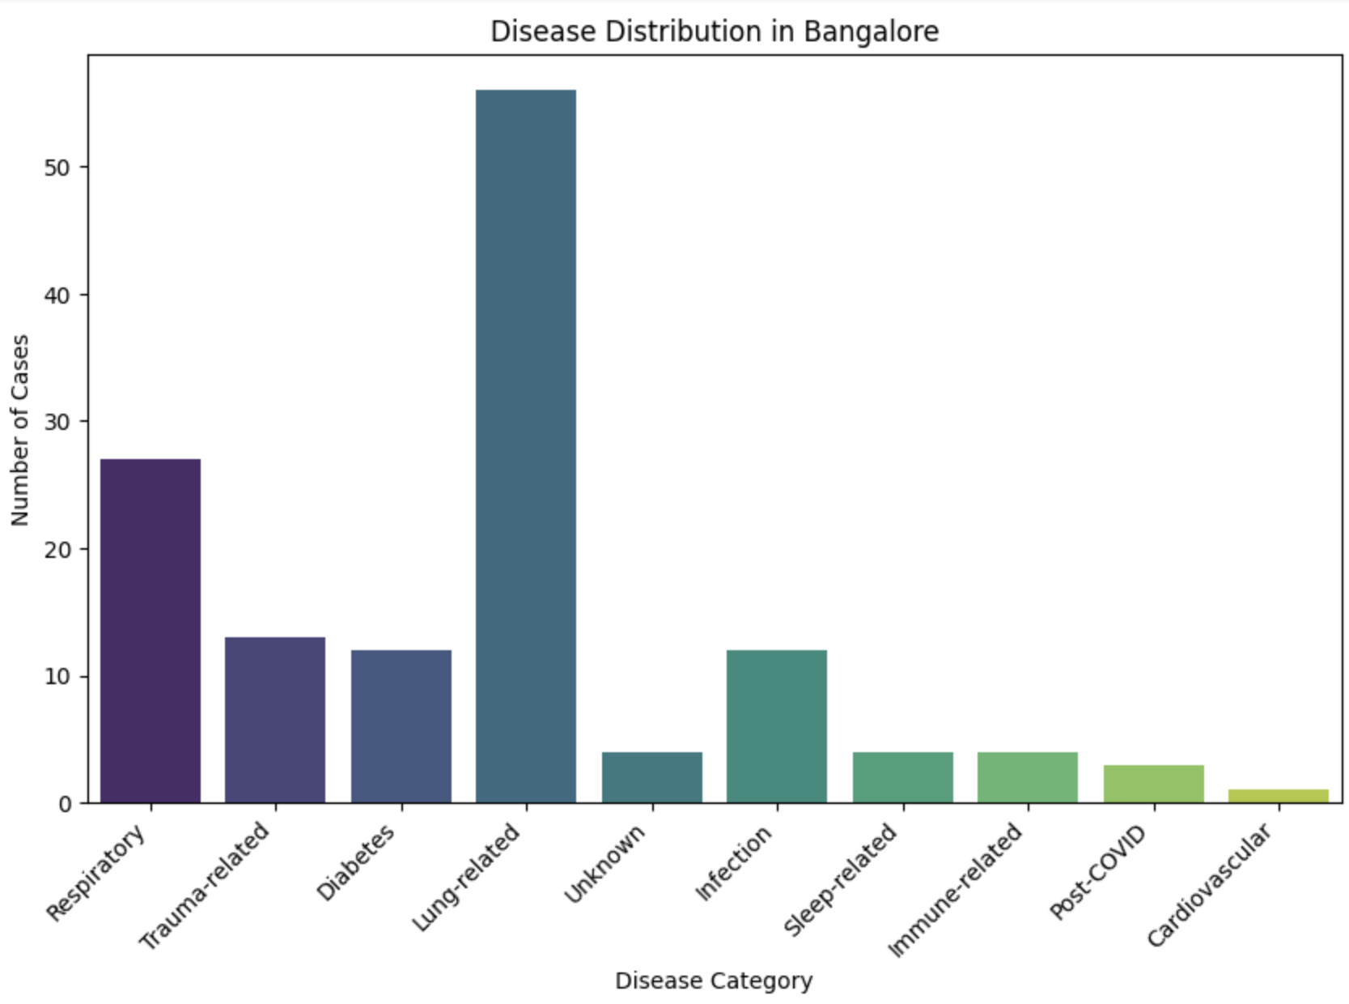
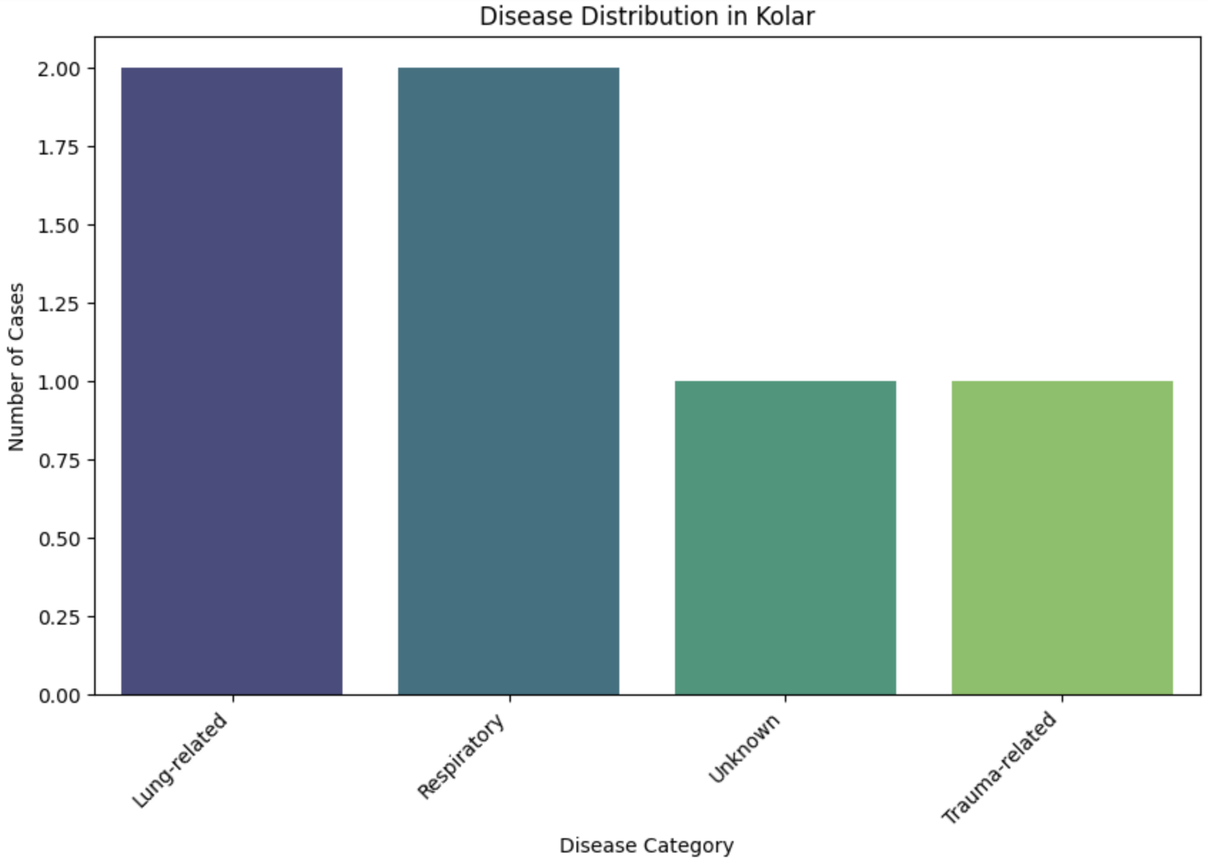
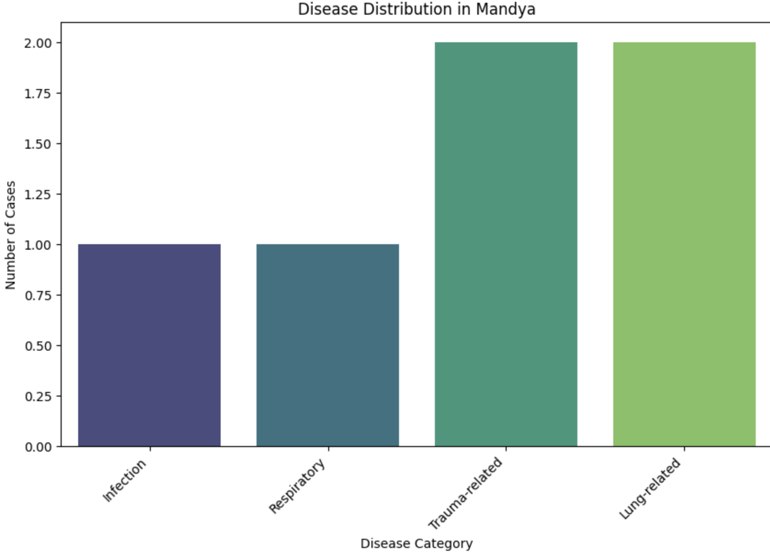
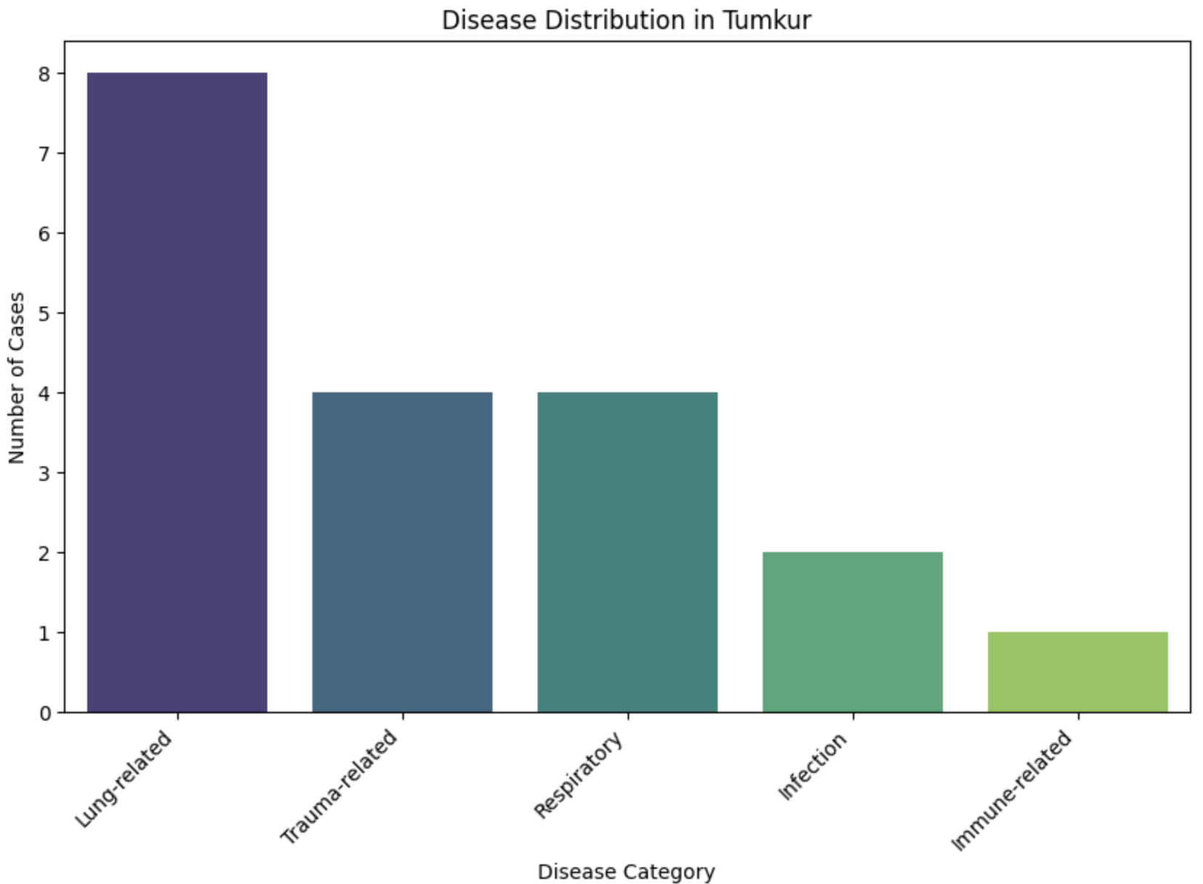
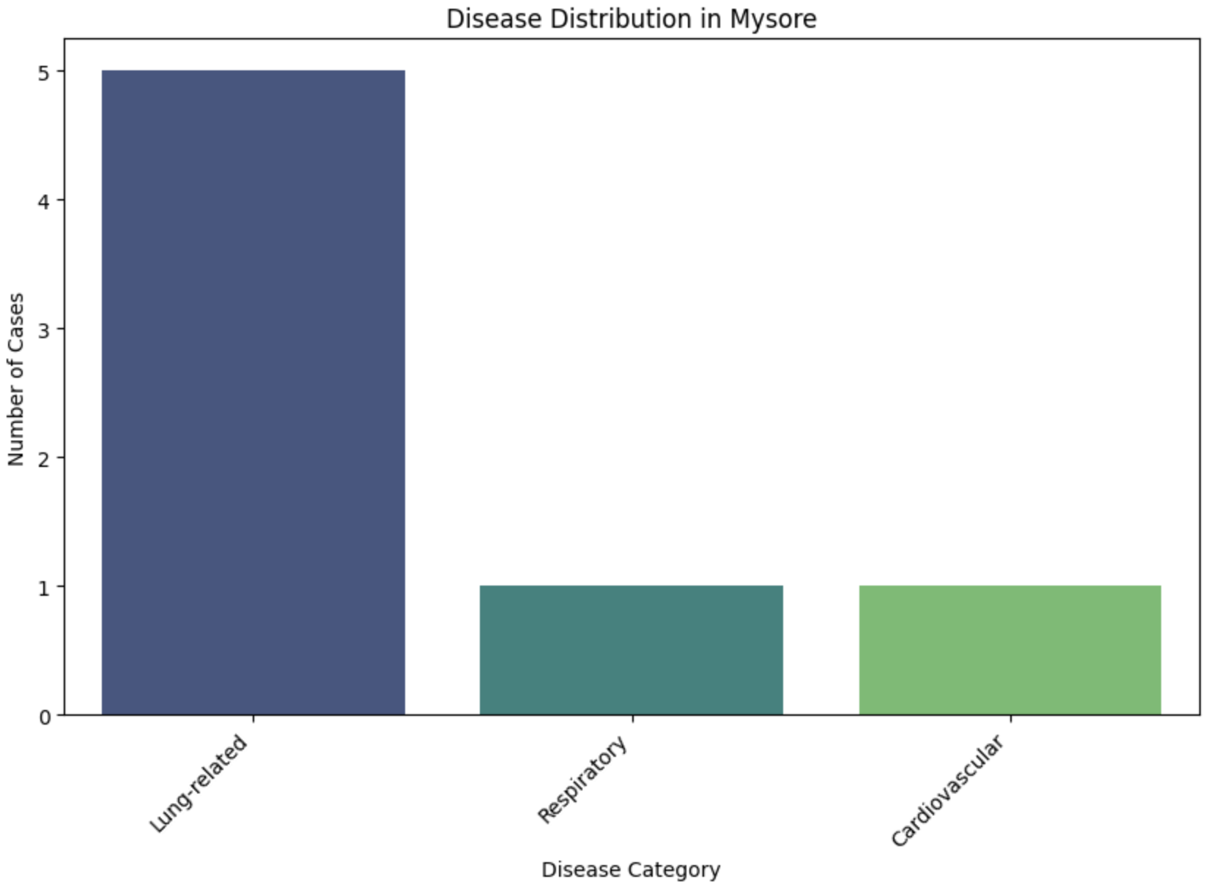
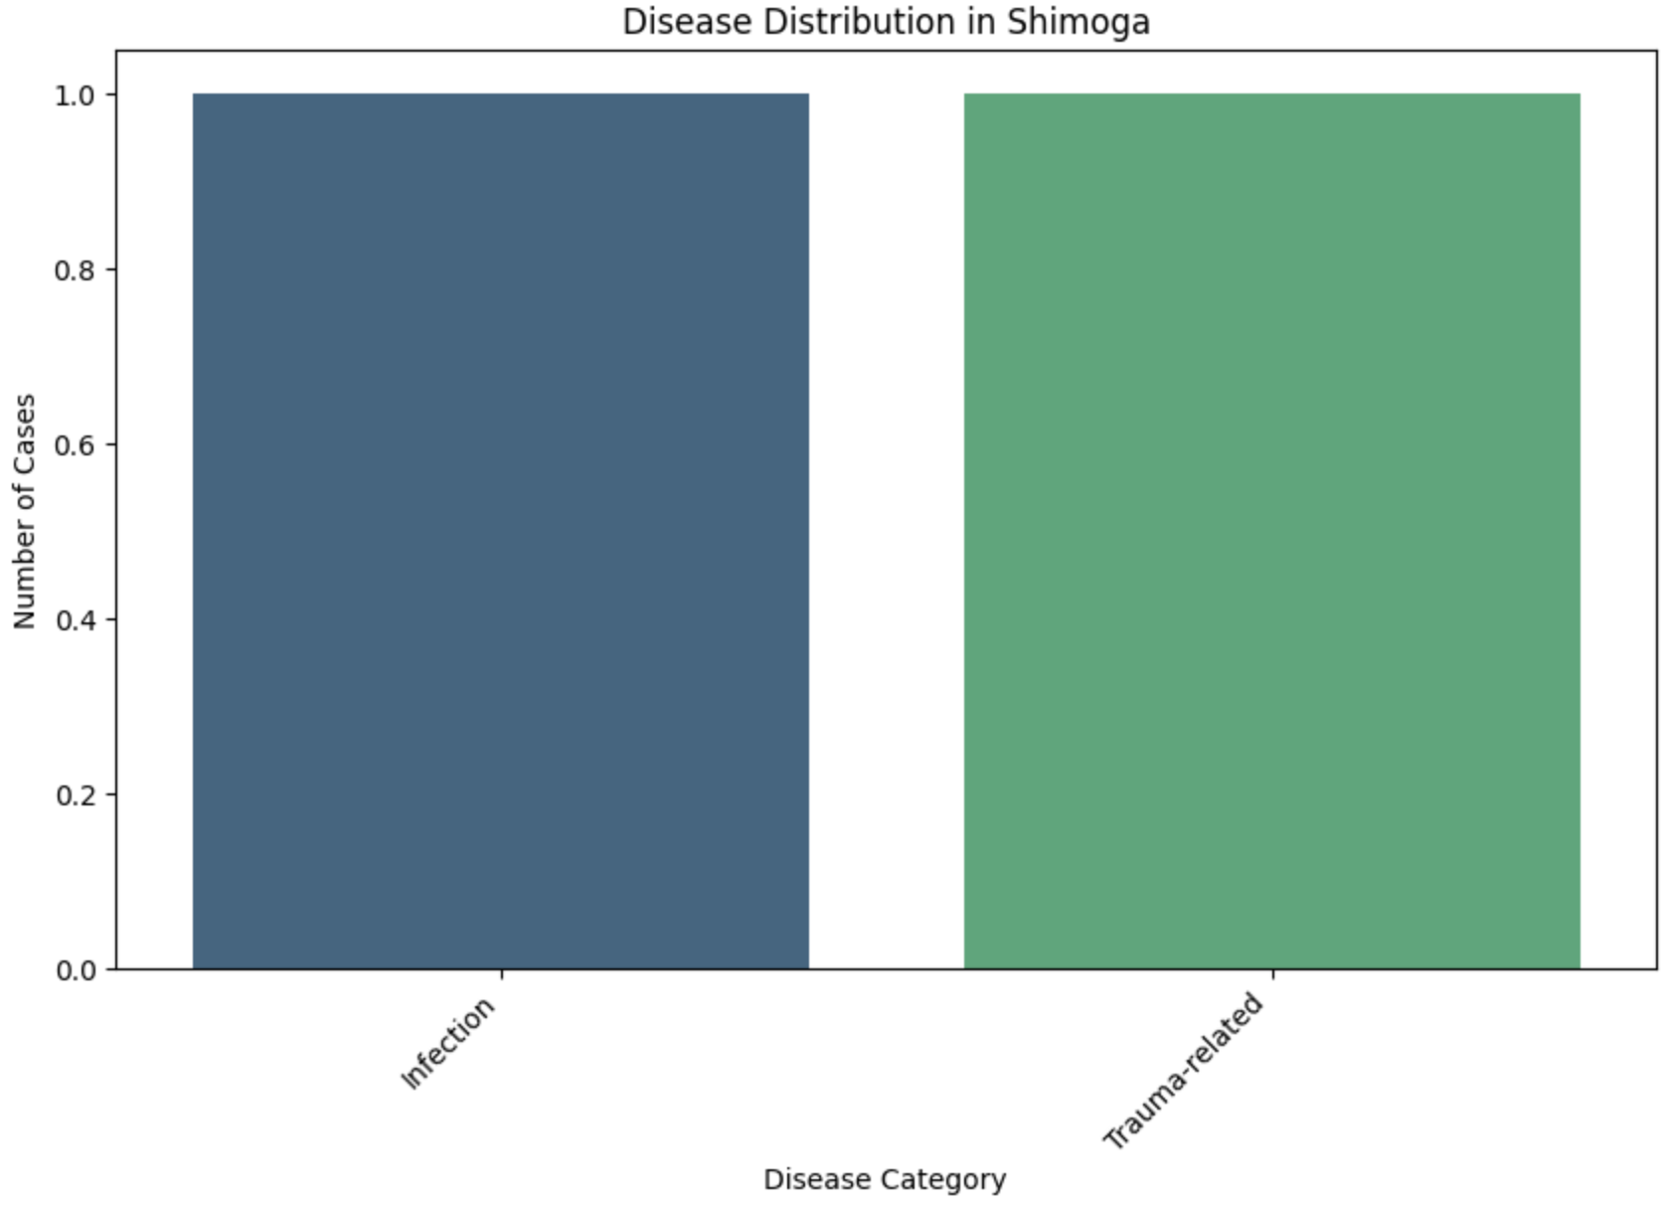
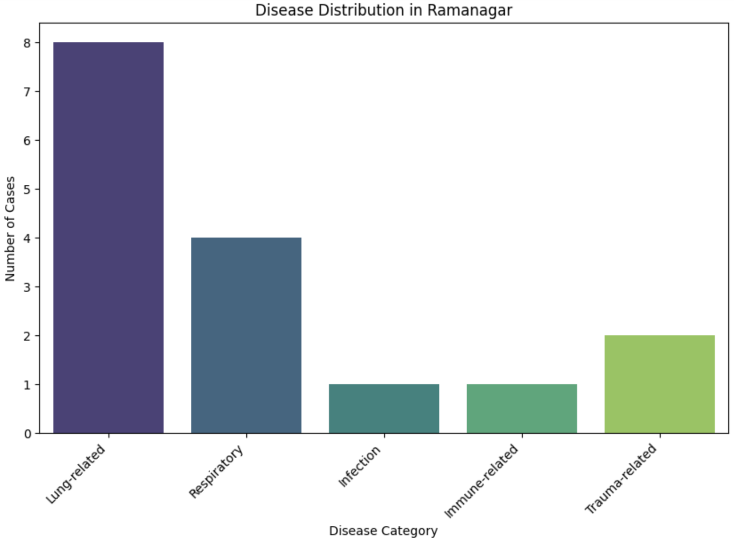
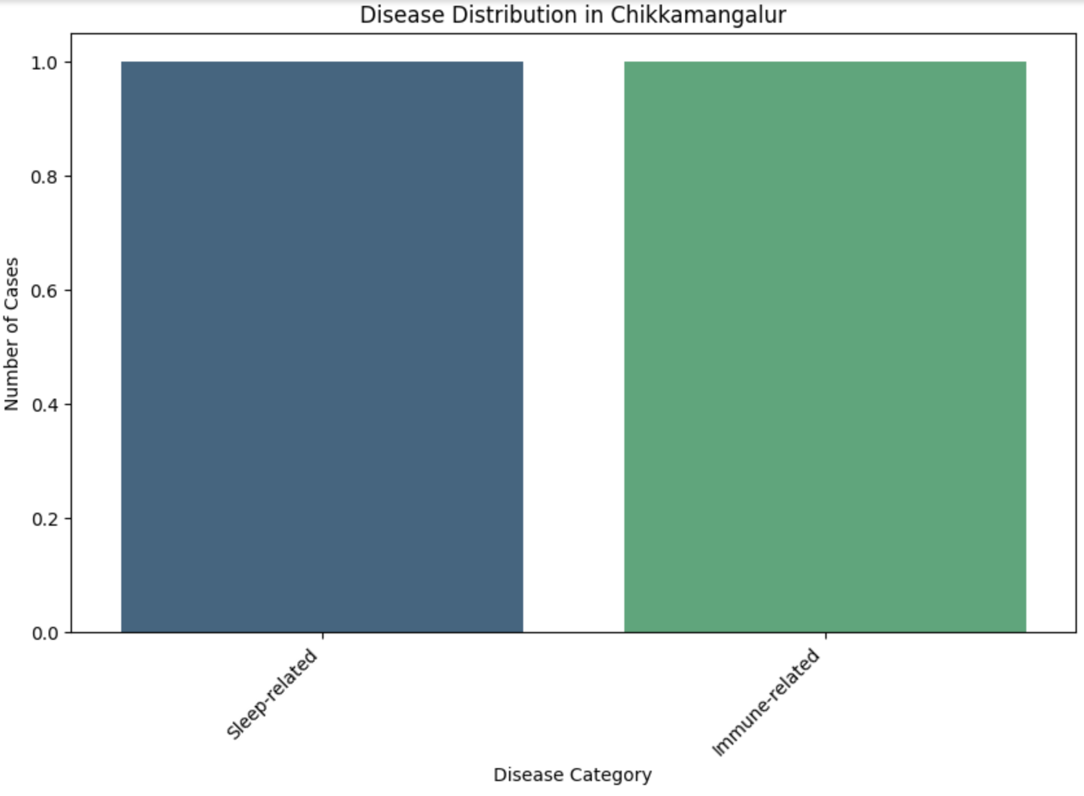
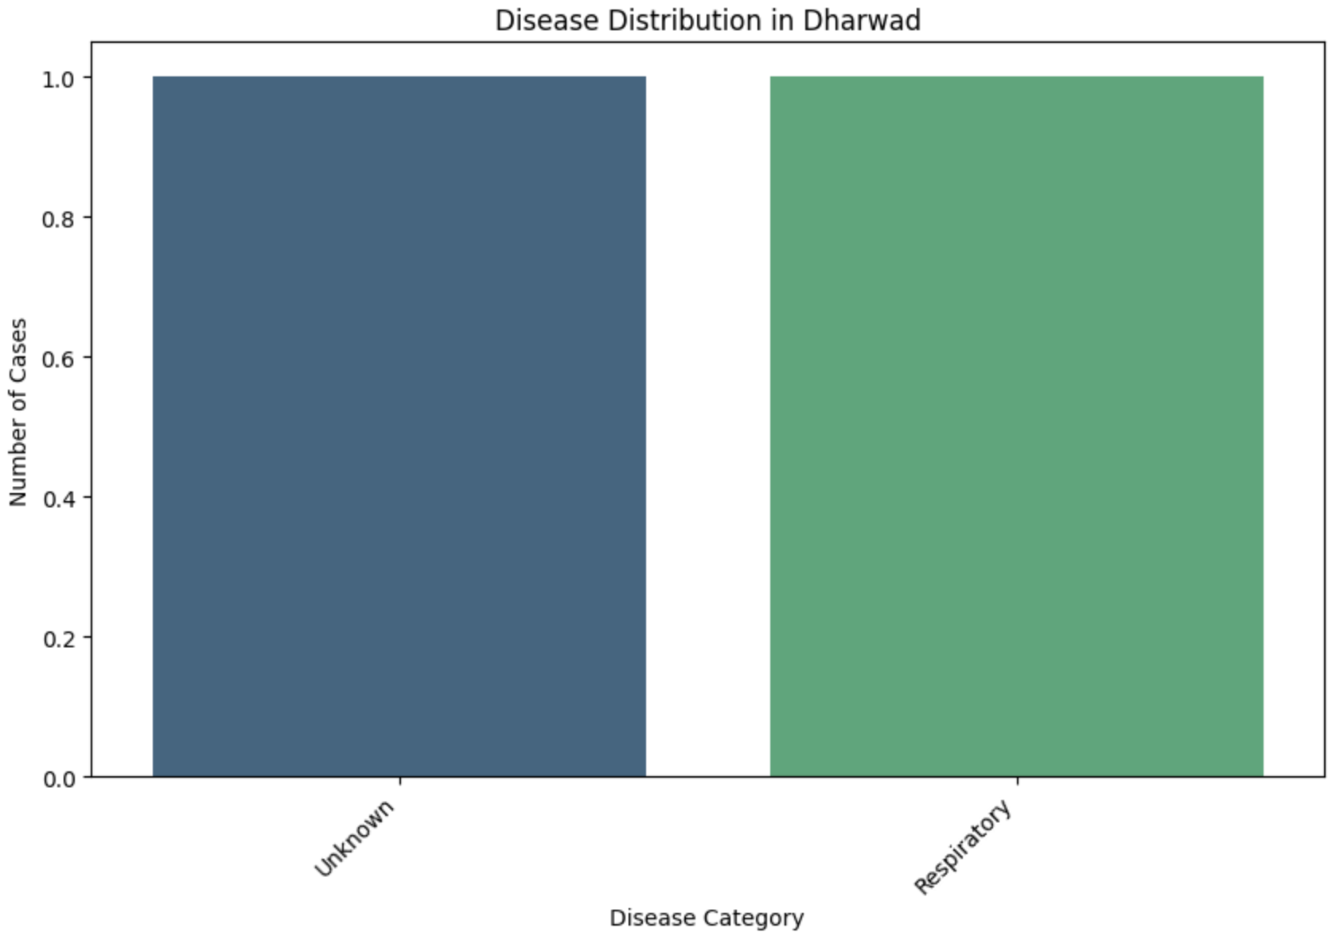
% of Diseases
Age vs Disease
Diseases based on Sex
Diseases based on Location
HEALTHCARE SOLUTION
RTWO
Diseases for Male on Location
Diseases for Female on Location
Age based on Location
HEALTHCARE SOLUTION
RTWO
HEALTHCARE SOLUTION
RTWO
HEALTHCARE SOLUTION
RTWO

Slide 10
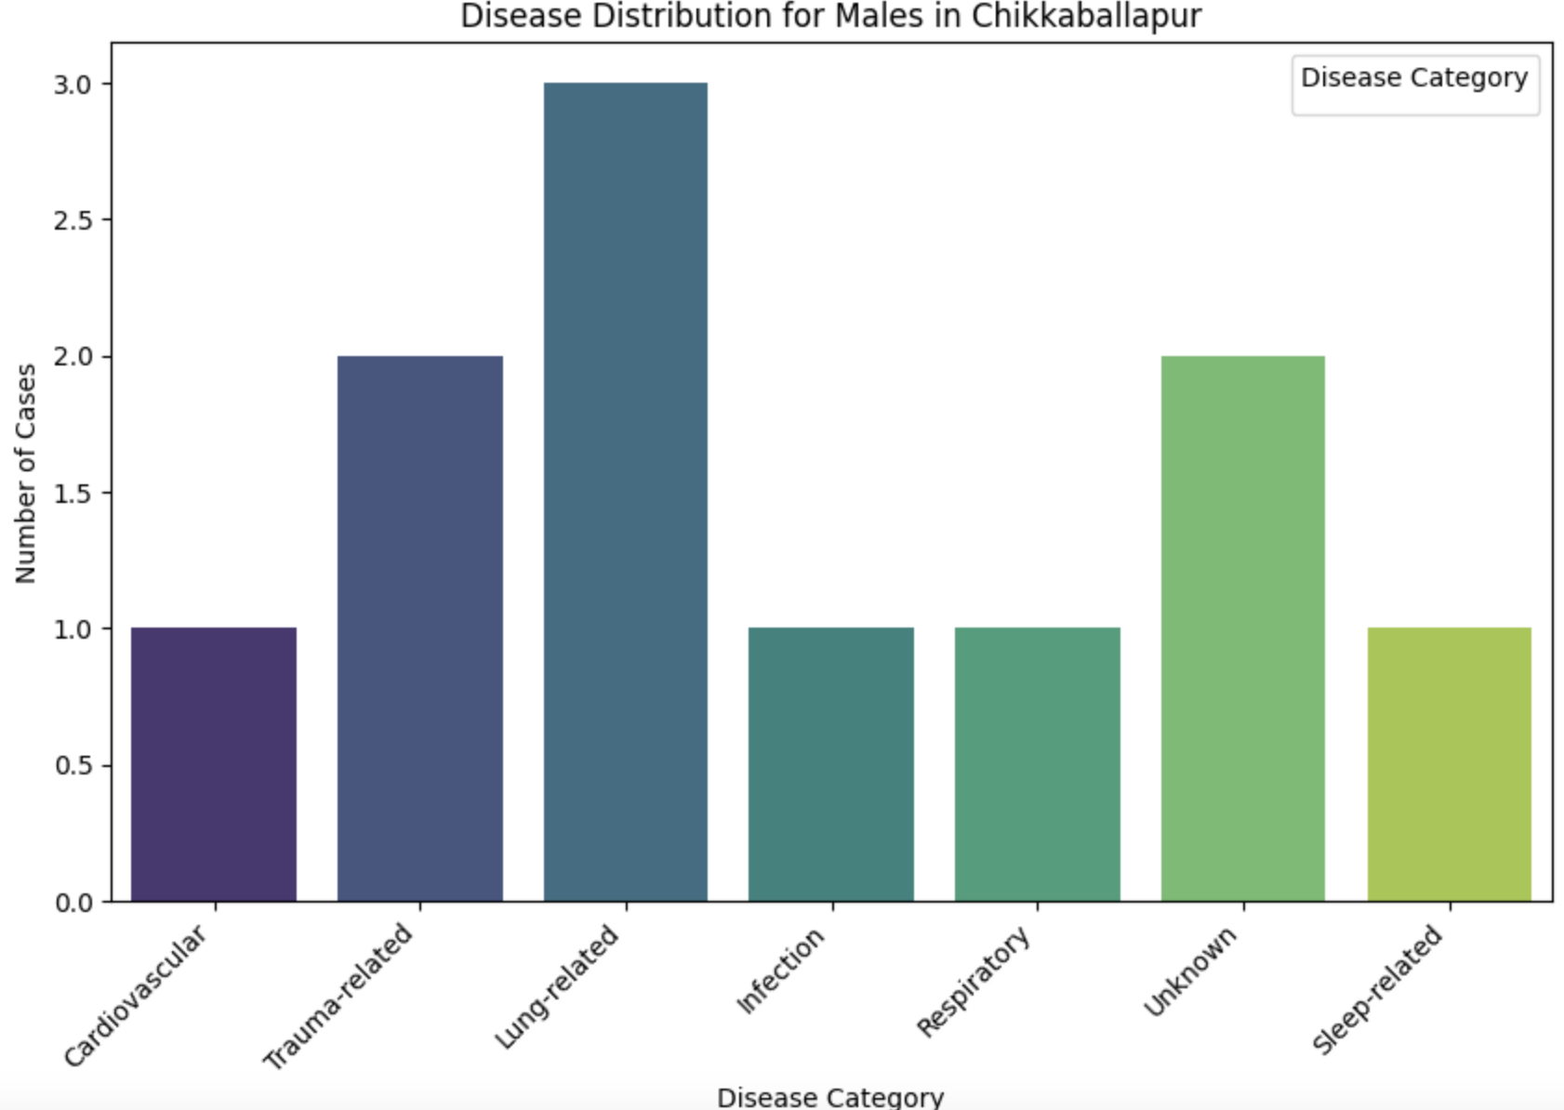
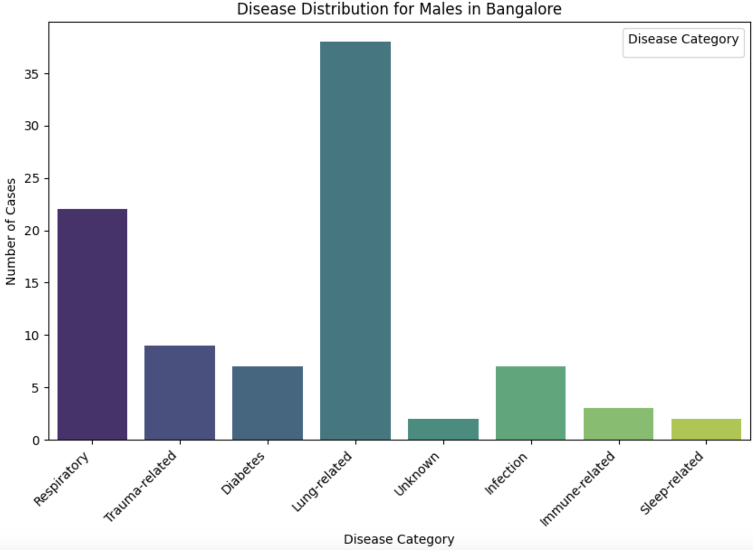
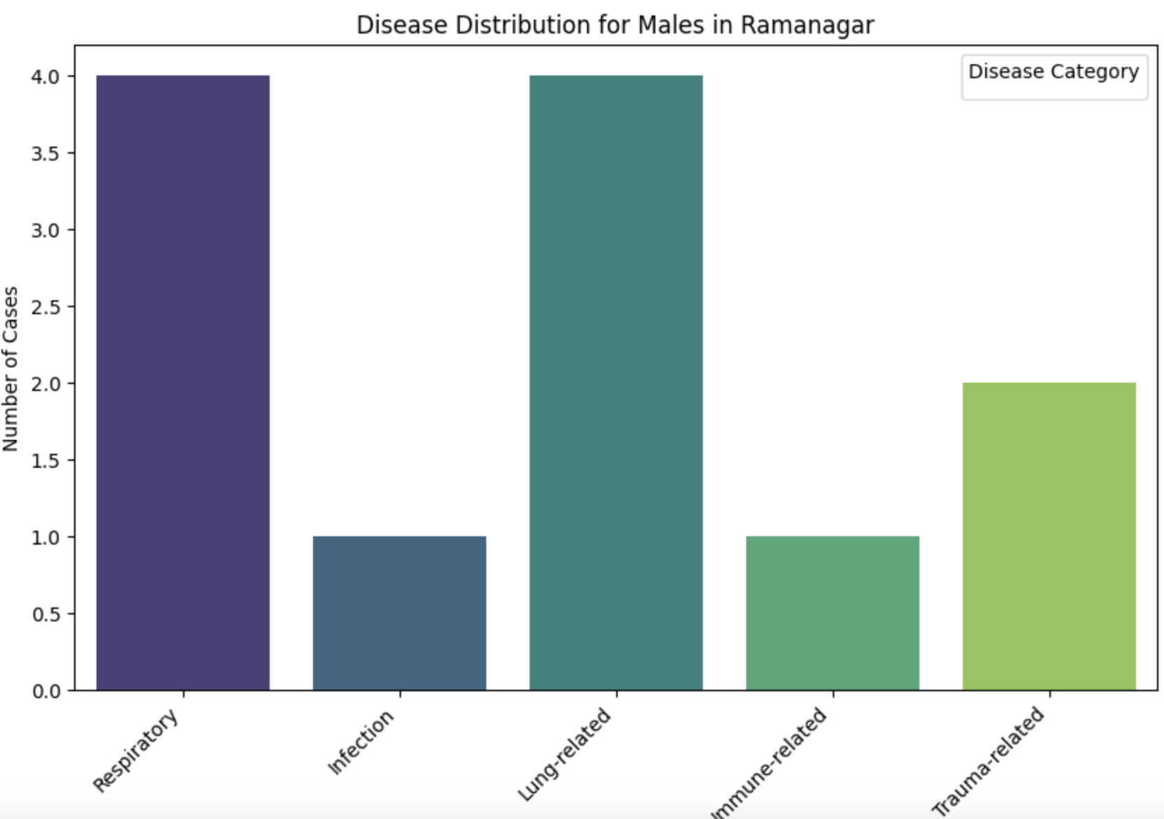
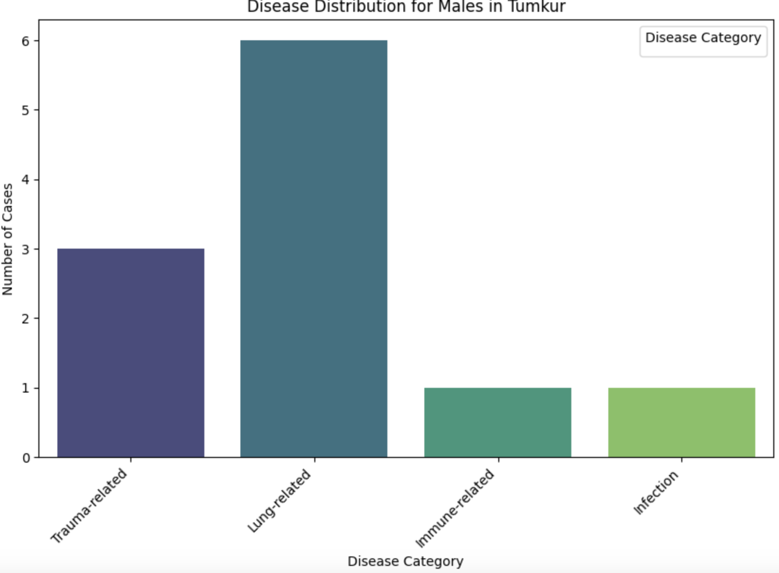
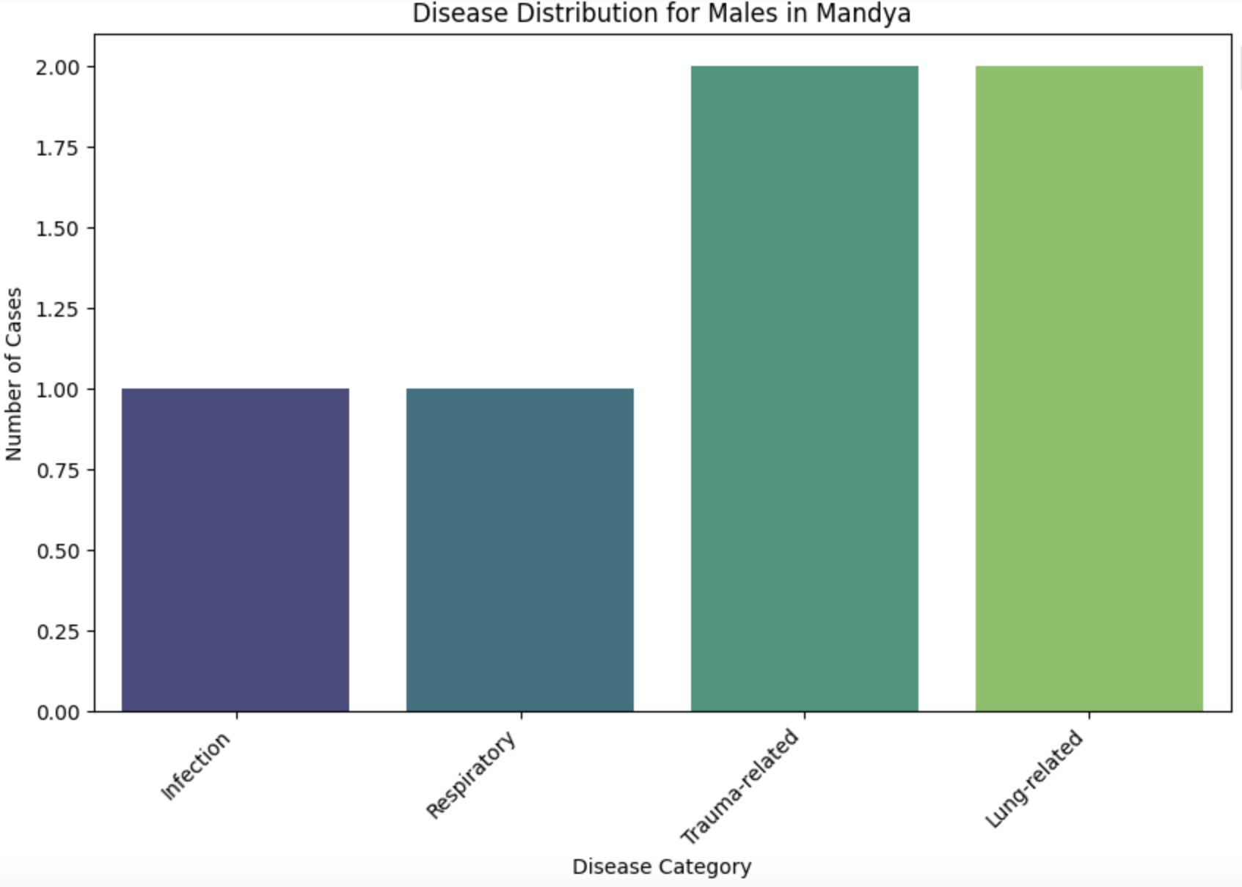
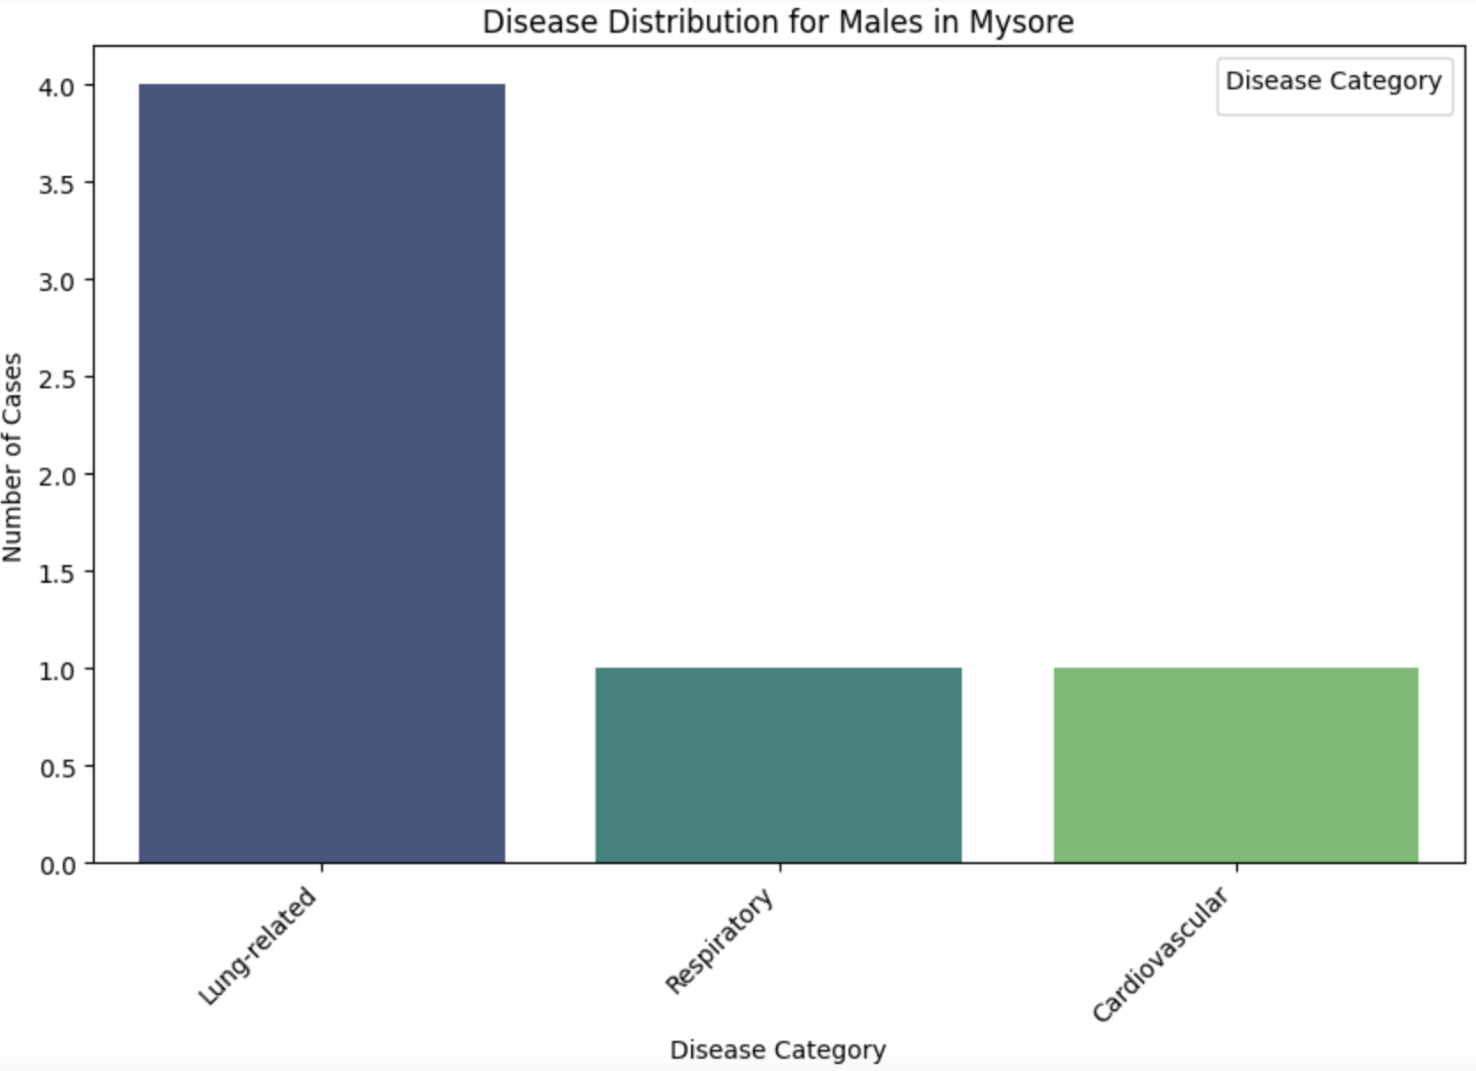
% of Diseases
Age vs Disease
Diseases based on Sex
Diseases based on Location
HEALTHCARE SOLUTION
RTWO
Diseases for Male on Location
Diseases for Female on Location
Age based on Location
HEALTHCARE SOLUTION
RTWO
HEALTHCARE SOLUTION
RTWO
HEALTHCARE SOLUTION
RTWO

Slide 11
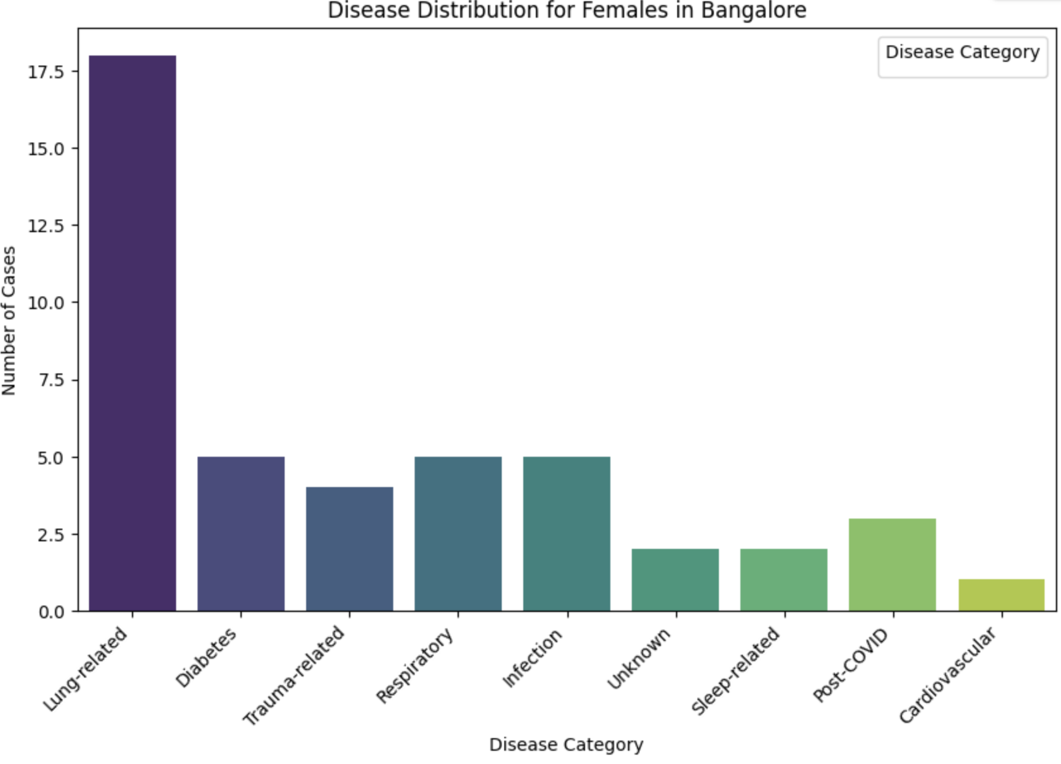
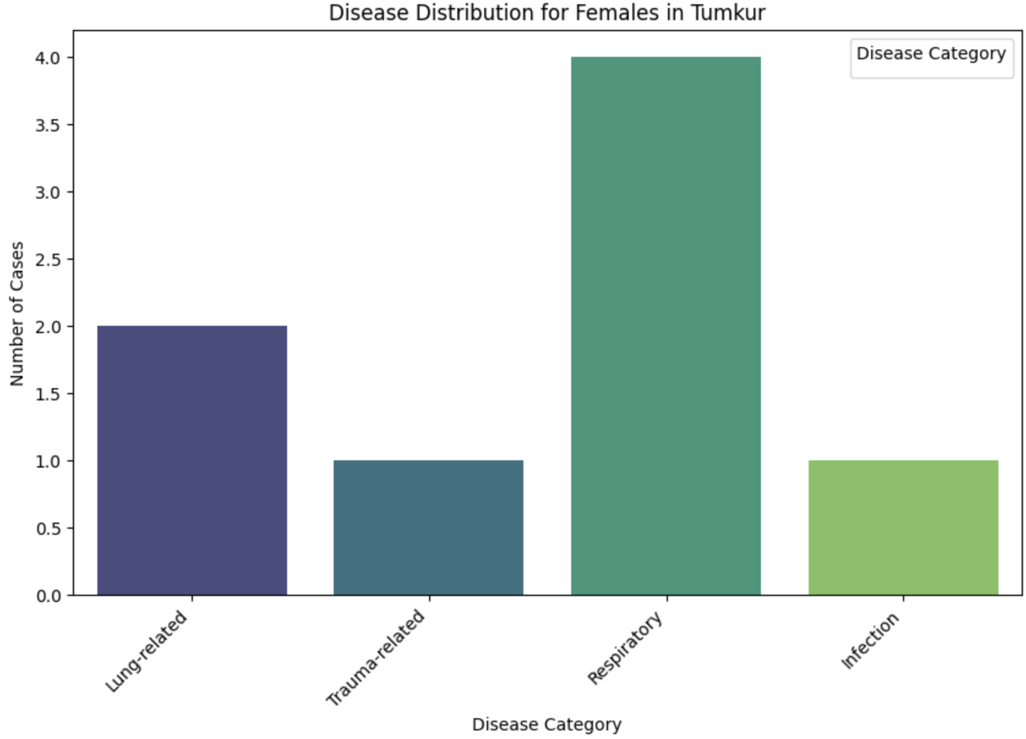
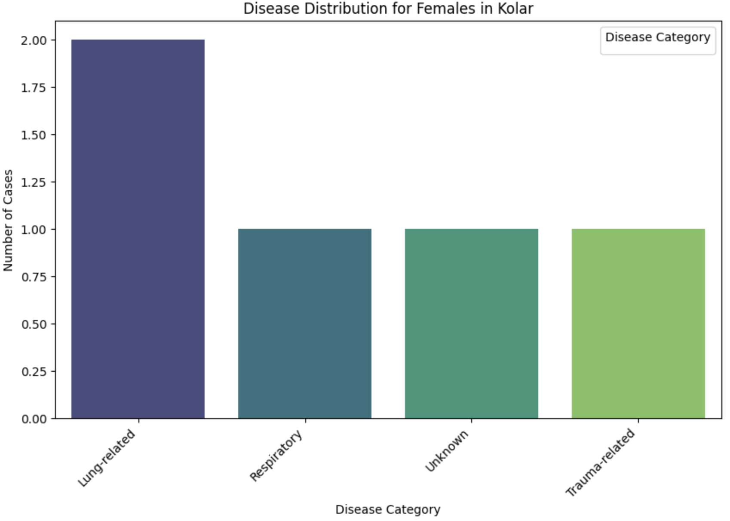
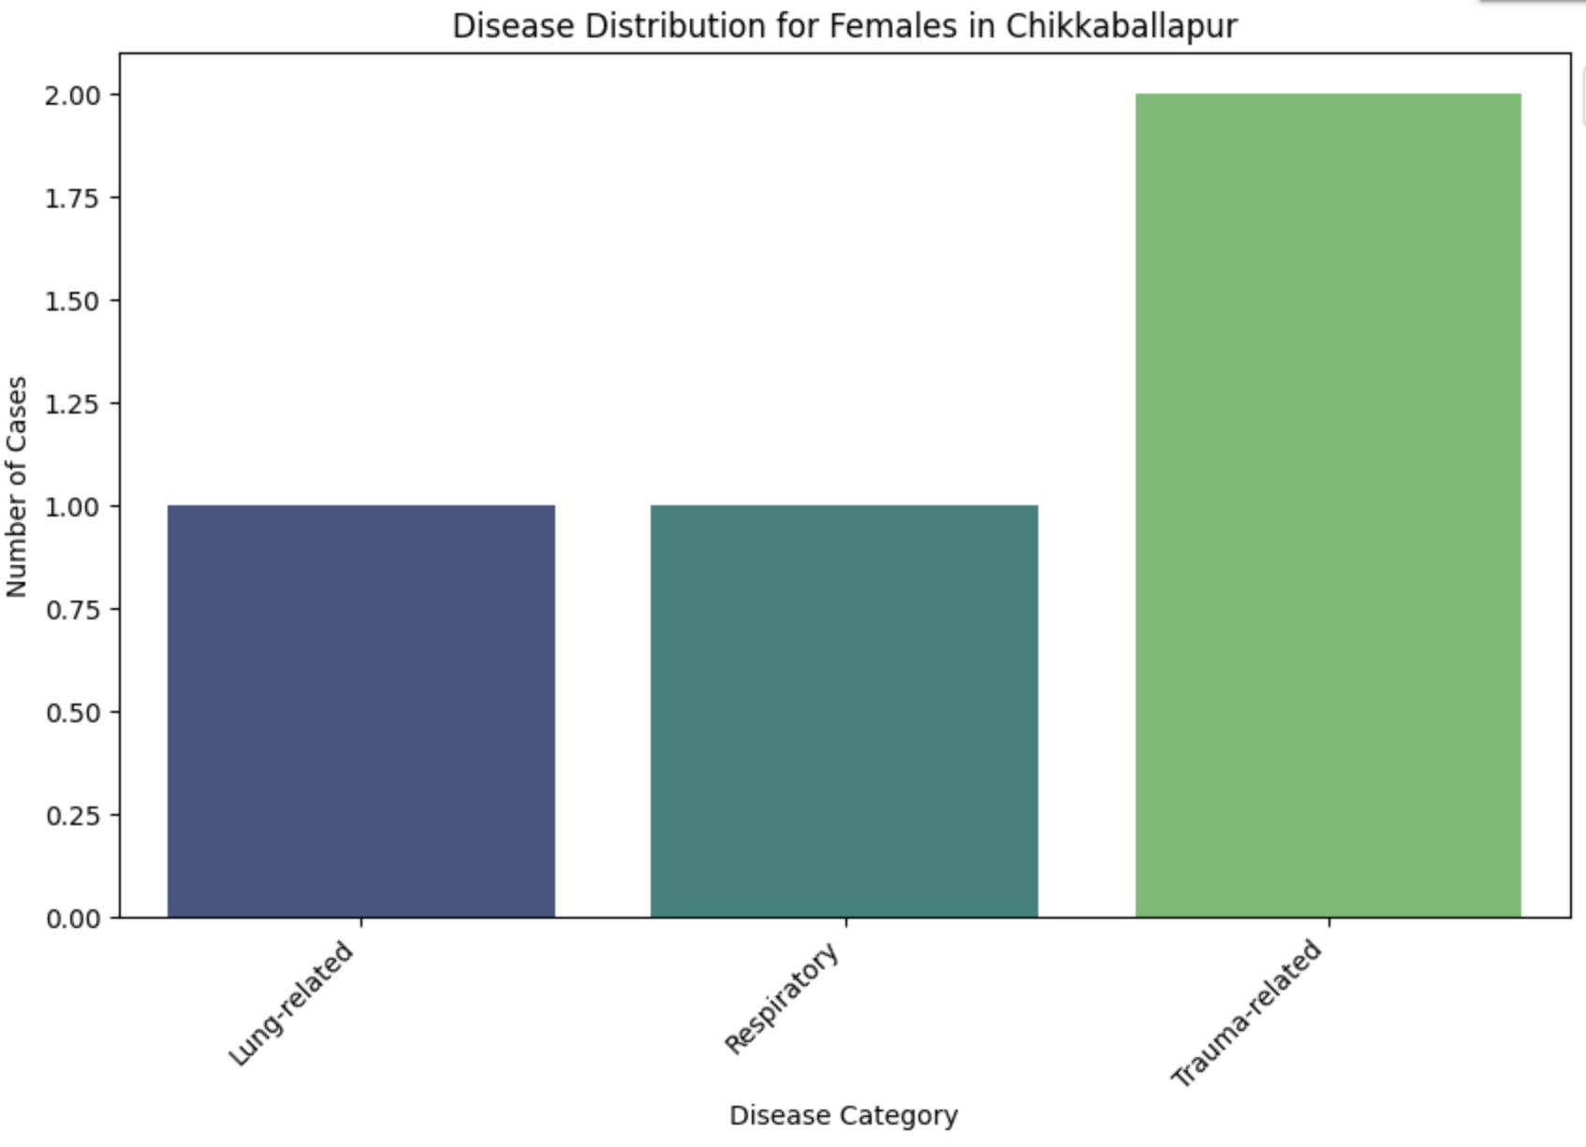
% of Diseases
Age vs Disease
Diseases based on Sex
Diseases based on Location
HEALTHCARE SOLUTION
RTWO
Diseases for Male on Location
Diseases for Female on Location
Age based on Location
HEALTHCARE SOLUTION
RTWO
HEALTHCARE SOLUTION
RTWO
HEALTHCARE SOLUTION
RTWO

Slide 12
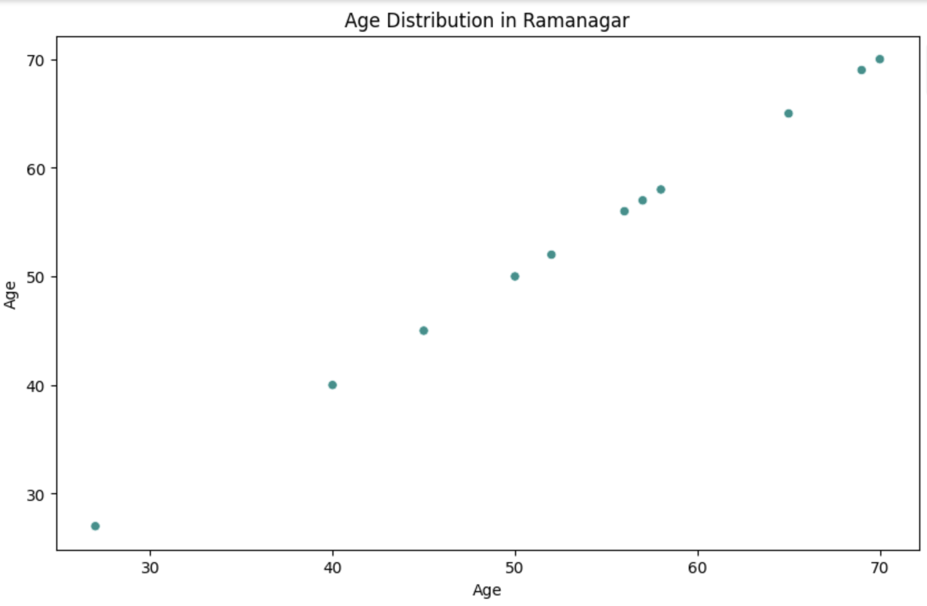
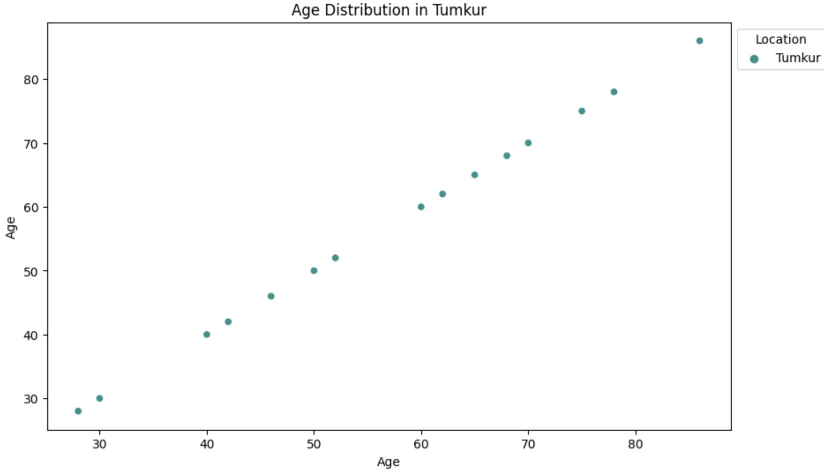
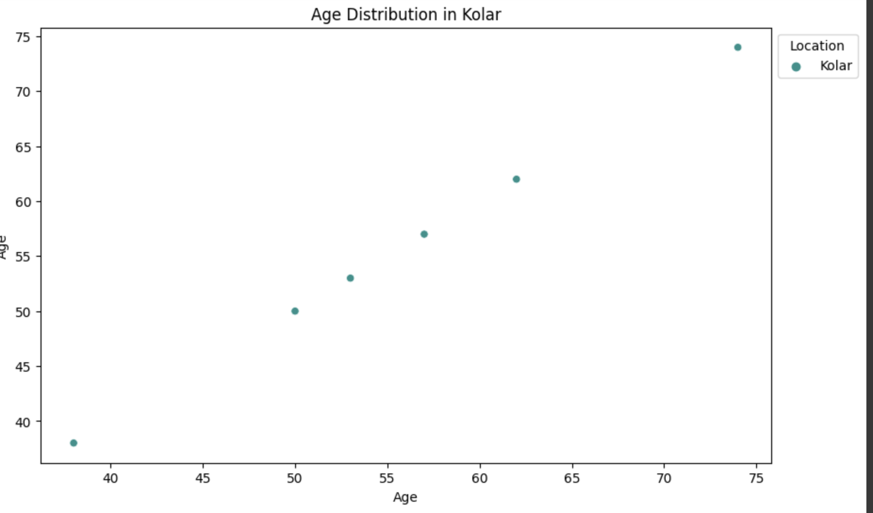
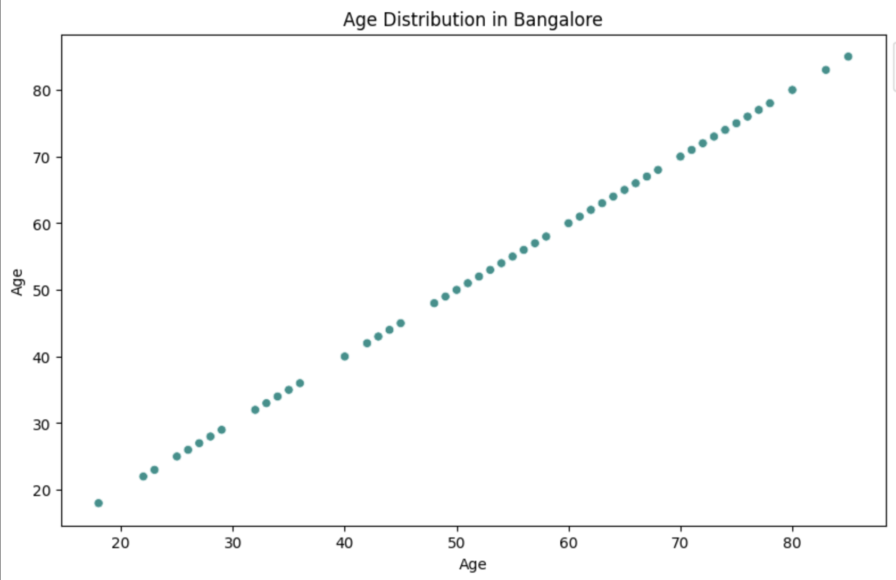
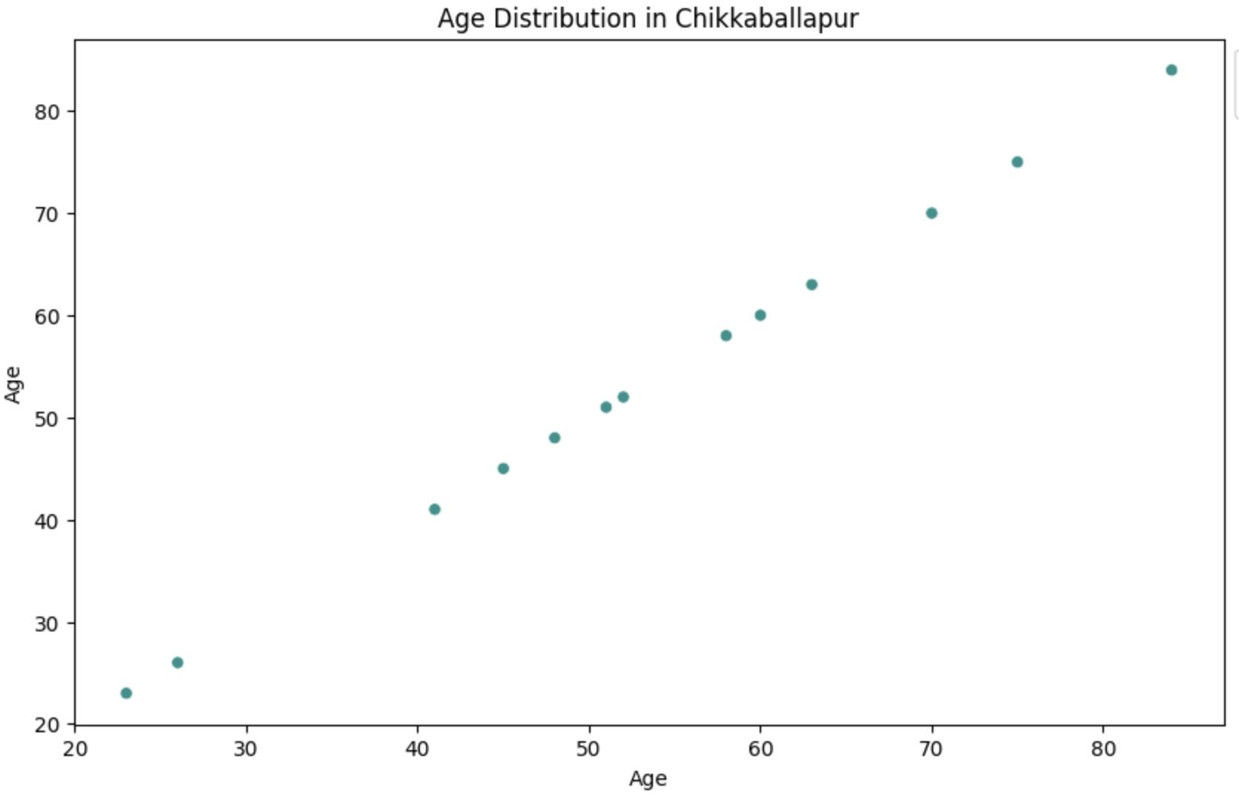
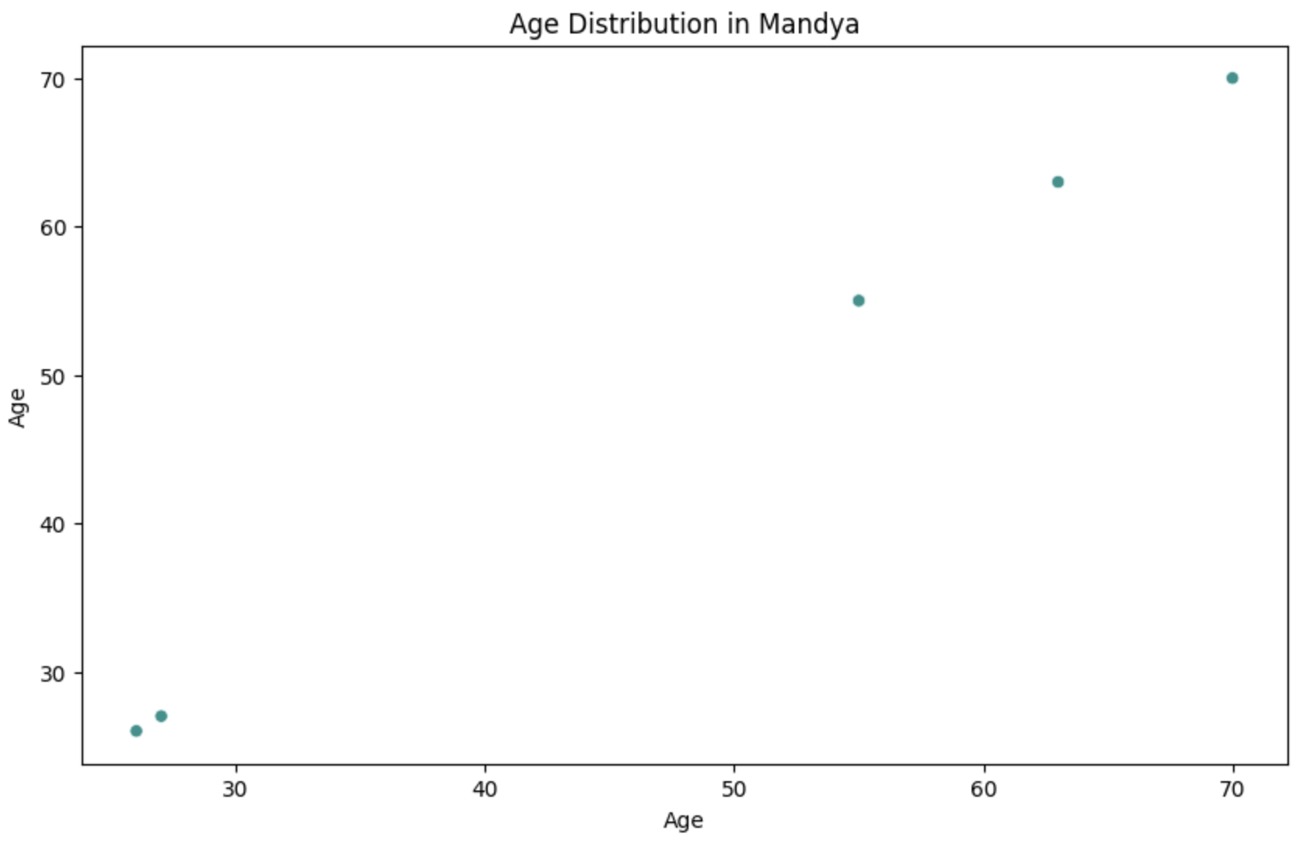
% of Diseases
Age vs Disease
Diseases based on Sex
Diseases based on Location
HEALTHCARE SOLUTION
RTWO
Diseases for Male on Location
Diseases for Female on Location
Age based on Location
HEALTHCARE SOLUTION
RTWO
HEALTHCARE SOLUTION
RTWO
HEALTHCARE SOLUTION
RTWO

